Slide 1

Schedule III
Of Companies Act-2013

Slide 2
Schedule III
GENERAL INSTRUCTIONS FOR PREPARATION OF BALANCE SHEET AND STATEMENT OF PROFIT AND LOSS OF A COMPANY
Balance sheet - A balance sheet is a financial statement that reports a company's assets, liabilities and shareholders' equity at a specific point in time, and provides a basis for computing rates of return and evaluating its capital structure.
Profit and loss - The profit and loss (P&L) statement is a financial statement that summarizes the revenues, costs, and expenses incurred during a specified period, usually a fiscal quarter or year.

Slide 3

Schedule III GENERAL INSTRUCTIONS
Applicable for all FS from 1/4/2014
PART 1- BALANCE SHEET
PART II- PROFIT AND LOSS ACCOUNT
* Supremacy given to Ind AS and Companies Act 2013
* Cross referencing required for each item on the financial statements to NOTES and not to Schedules.
• Format of Cash Flow Statement is not prescribed in Schedule III. It is governed by Ind AS on Cash Flow Statement
There should be comparatives for the years.

Slide 4
Balance Sheet

Slide 5
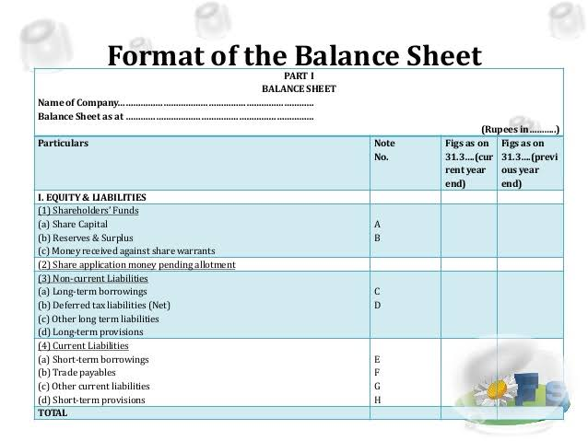

Slide 6
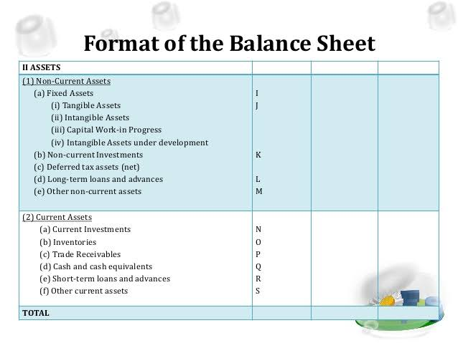

Slide 7

Equity & Liability classification
Equity and Liability Classification
Shareholders Fund
Non-Current Liabilities
Current Liabilities
Share Application Money Pending Allotment
Share Capital
Long-Term Borrowings
Short-Term Borrows
Reserve and Surplus
Deferred Tax Liabilities (Net)
Trade Payables
Money receIved against Share Warrants
Other Current Liabilities
Other LT Liabilities
Long-term Provisions
Short term Provisions

Slide 8
CURRENT & NON CURRENT CLASSIFICATION
A liability shall be classified as current when it satisfies any of the following criteria:—
(a) it is expected to be settled in the company’s normal operating cycle;
(b) it is held primarily for the purpose of being traded;
(c) it is due to be settled within twelve months after the reporting date; or
(d) the company does not have an unconditional right to defer settlement of the
liability for at least twelve months after the reporting date. Terms of a liability that
could, at the option of the counterparty, result in its settlement by the issue of equity
instruments do not affect its classification.
All other liabilities shall be classified as non-current.
Notes:
after reporting reporting

Slide 9

ASSET CLASSIFICATION
ASSETS
Current assets
Non current assets
Tangible assets
Current investments
Fixed Assets
Intangible assets
Non-current investment
Inventories
Deferred Tax asset(net)
Trade receivable
LT loans & advance
Cash & Cash Equivalents

Slide 10
CURRENT & NON CURRENT CLASSIFICATION
An asset shall be classified as current when it satisfies any of the following criteria:—
(a) it is expected to be realized in, or is intended for sale or consumption in, the
company’s normal operating cycle;
(b) it is held primarily for the purpose of being traded;
(c) it is expected to be realised within twelve months after the reporting date; or
(d) it is cash or cash equivalent unless it is restricted from being exchanged or
used to settle a liability for at least twelve months after the reporting date.
All other assets shall be classified as non-current.
Notes:
after reporting reporting

Slide 11
Profit and loss account

Slide 12
STATEMENT OF PROFIT AND LOSS
INCOME - EXPENSE = (+) PROFIT
INCOME - EXPENSE = (-) LOSS

Slide 13
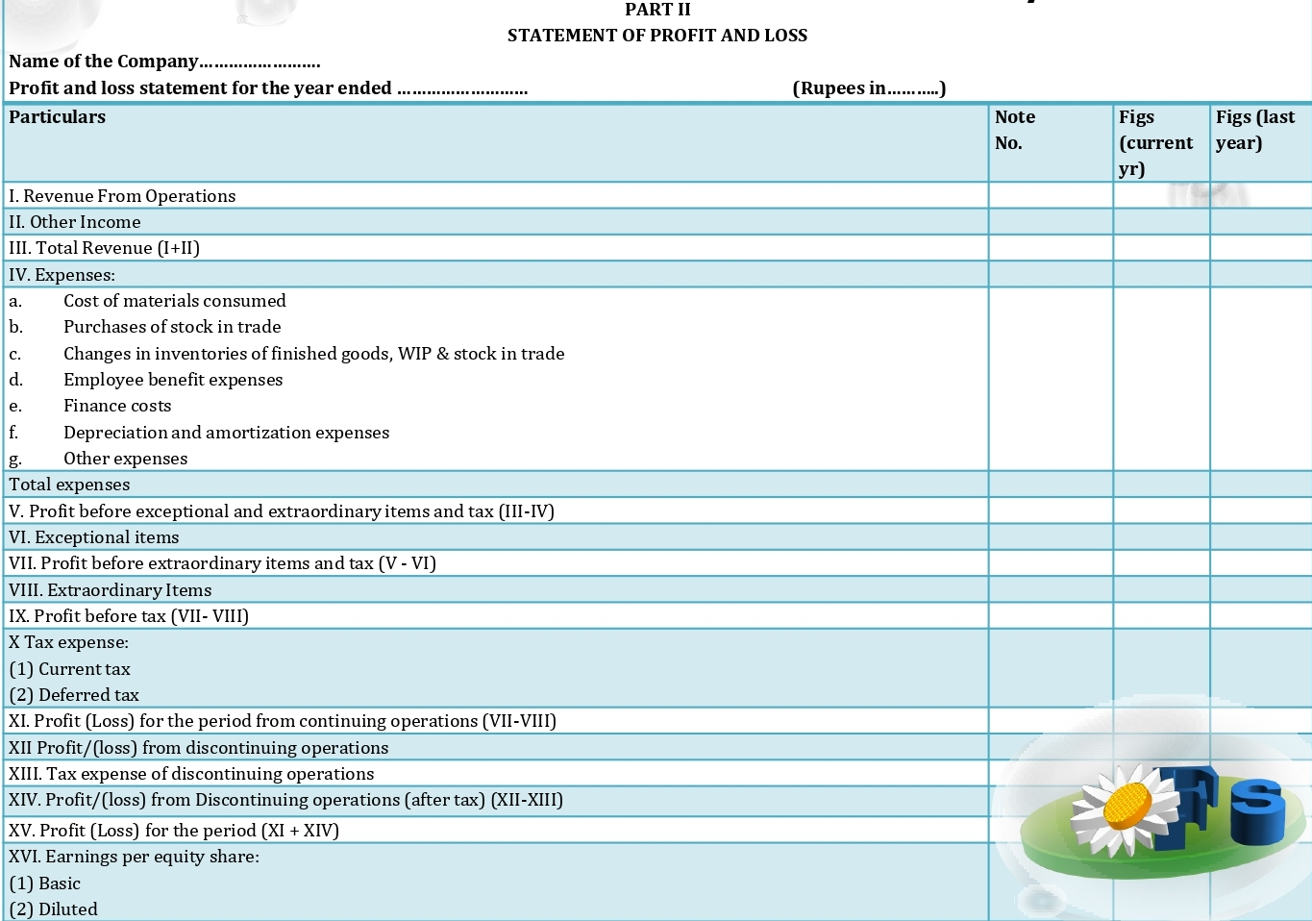
FORMAT OF PROFIT AND LOSS A/C

Slide 14

GENERAL INSTRUCTIONS FOR PREPARATION OF PROFIT AND LOSS
A.
A company other than a Finance company revenue from operations shall disclose separately in the notes revenue from —
(a) Sale of products
(b) Sale of services
(c) Other operating revenues
(d) Excise duty
A Finance company, revenue from operations shall include revenue from—
(a) Interest
(b) Other financial services.
B.
Revenue under each of the above heads shall be disclosed separately by way of notes to accounts to the extent applicable.

Slide 15

Finance Costs
Finance costs shall be classified as:
(a) Interest expense;
(b) Other borrowing costs ;
(c) Applicable net gain/loss (on foreign currency transactions
and translation.)
C.
D. Other income
Other income shall be classified as:
(a) Interest Income (in case of a company other than
a Finance company;
(b) Dividend Income;
(c) Net gain/loss on sale of Investments ;
(d) Other non-operating income (net of expenses directly attributable to
such income).

Slide 16

E. Additional Information
A Company shall disclose by way of notes additional information
Regarding aggregate expenditure and income on the following items:—
(A) Employee Benefits Expense
(i) salaries and wages,
(ii) contribution to provident and other funds
(iii) expense on Employee Stock Option Scheme (ESOP) and Employee Stock
Purchase Plan (ESPP)
(iv) staff welfare expenses
(B) Depreciation and amortization expense;
(C) Any item of income or expenditure which exceeds one per cent. of the
revenue from operations or Rs.1,00,000, whichever is higher;
(D) Interest Income;
(E) Interest expense;
(F) Dividend income;

Slide 17
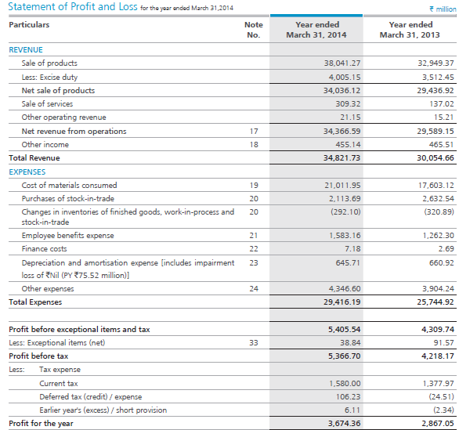
EXAMPLE :

Slide 18

General Instructions for preparation of CFS
The consolidated financial statements shall disclose the information as per the requirements specified in the applicable Accounting Standards including the following:
(i) Profit or loss attributable to “minority interest” and to owners of the parent in
the statement of profit and loss shall be presented as allocation for the period.
(ii) “Minority interests” in the balance sheet within equity shall be presented.

Slide 19

Consolidated Financial Statements
All subsidiaries, associates and joint ventures (whether Indian or foreign) will be covered under consolidated financial statements.
An entity shall disclose the list of subsidiaries or associates or joint ventures which have not been consolidated in the consolidated financial statements along with the reasons
of not consolidating.

Slide 20
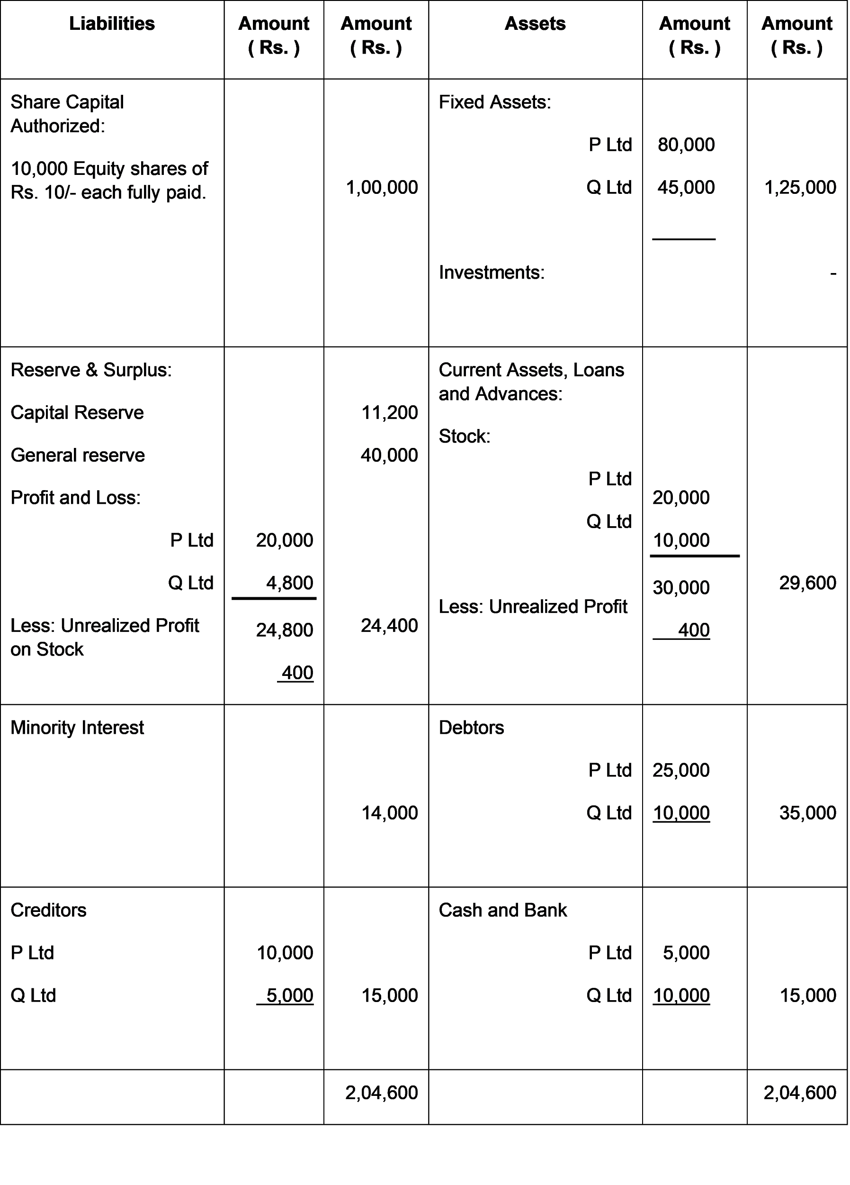
Consolidated Balance Sheet P Ltd and it is Subsidiary Q Ltd

